Slide 1
进展汇报
2021.10.22

Slide 2
本周进展
撰写毕业论文。
阅读一篇VR康复相关的论文。

Slide 3
The Impact of Implicit and Explicit Feedback on Performance and Experience during VR-Supported Motor Rehabilitation
IEEE VR 2021

Slide 4
Introduction
1. Virtual Reality Therapy (VRT) is known to provide effective alternatives to various traditional therapy approaches.
2. It is crucial to investigate essential mechanisms and gain a deeper understanding
for application designs that maximize the experience.
3. Previous work primarily focused on presenting a plausible and compelling virtual exercise environment in addition to motivational aspects to engage patients.

Slide 5
Introduction
4. VR provides a myriad of potential feedback mechanisms. However, which of these are most effective in improving the performance for a specific goal tackled by both the general and the individual therapy session?
5. The present work aims to
(1) develop a VR-based gait rehabilitation system including implicit and explicit feedback. (2) investigate the influence of feedback (implicit and explicit) on the performance and experience of patients.
(3) explore the applicability of the system for therapeutic treatment.

Slide 6
Method
1. VR training
(1) Treadmill (Lokomat Nanos), HTC Vive, tracker attached to robot.
(2) The hands were bound to virtual bars.
(3) Six nature sceneries (grassland, forest, stream land, beach, farm, and desert).
(4) A virtual trainer driven by walk-animation cycles, walked either synchronously or asynchronously in front of the patients.

Slide 7
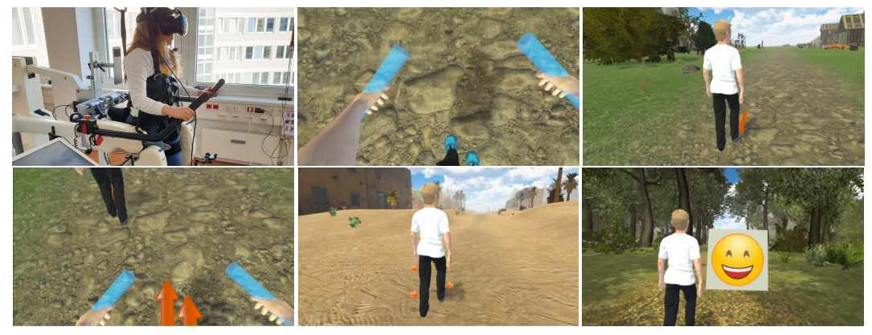
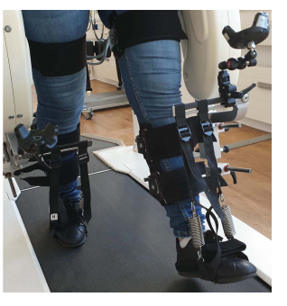
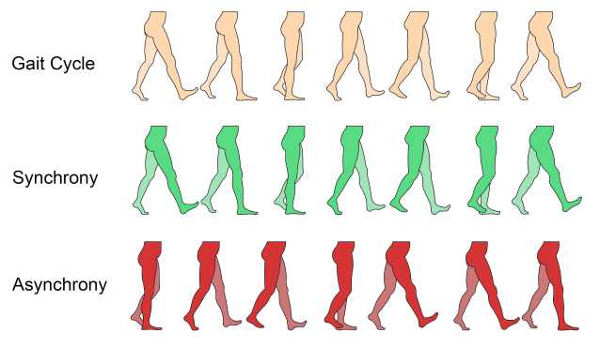
Method

Slide 8
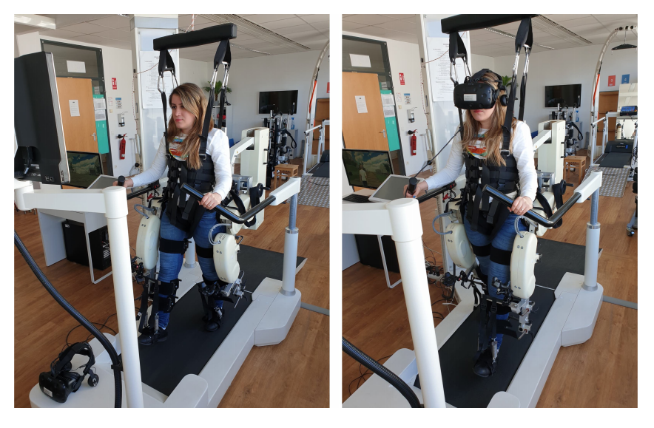
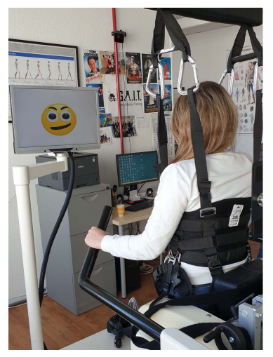
Method

Slide 9
Method
2. Measures
(1) Guidance force.
(2) Average speed.
(3) Walking distance.
(4) Number of pause.
(5) Intrinsic Motivation Inventory Scale (IMI).
(6) Task Load Index (TLX).
(7) User Satisfaction Evaluation Questionnaire (USEQ).

Slide 10
Method
2. Measures
(8) Simulator Sickness Questionnaire (SSQ).
(9) Functional Ambulation Categories Scale(FAC，功能性步行能力量表).

Slide 11
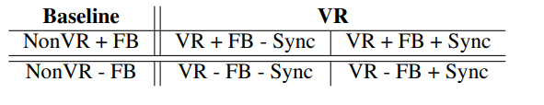
Method
3. Procedure
(1) 16 participants with gait impairment, an average age of 49.69 years.
(2) Each session 30 minutes, 784.5 meters.
(3) Auditory and visual feedback: “Good”, “Nice big steps”, “Keep it going”.
(4) Each participant took part in the study for six sessions and each session was implemented on a different day.

Slide 12
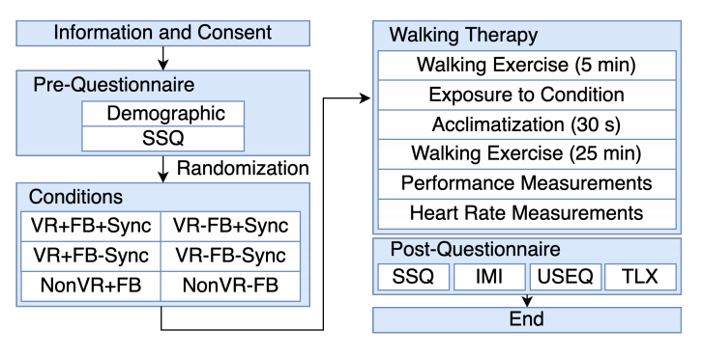

Slide 13
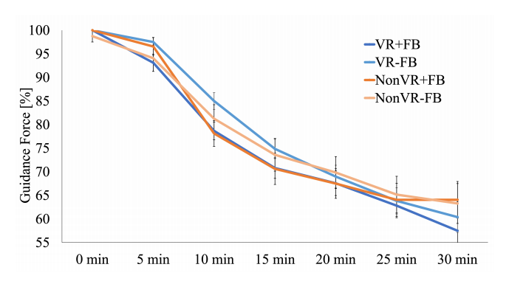
Results
1. Guidance Force:
(1) The results revealed a significant main effect for FEEDBACK and TIME.

Slide 14
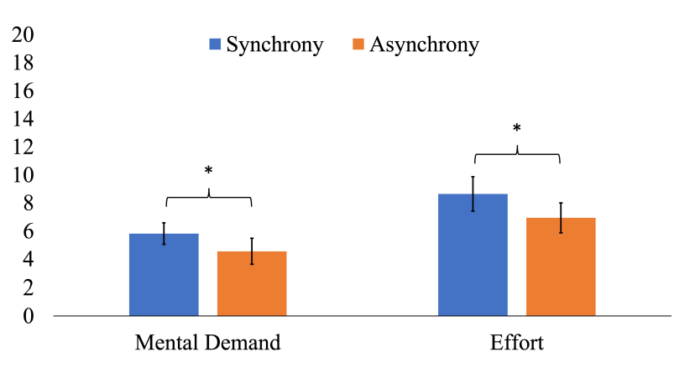
Results
2. User Satisfaction:
(1) VR resulted in significantly higher user satisfaction when compared to the NonVR conditions.
3. Task Load:
(1) The VR conditions with synchronous walking resulted in significantly higher in mental demand.

Slide 15
Discussion
1. The applied support force reduced considerably when explicit feedback was presented to the patients.
2. The explicit feedback in the VR condition may not have had a significant impact on the experience.
3. The patients required more mental activities when they attempted to match their walking movements with the virtual trainer.
4. The patients were more satisfied with the VR rehabilitation approach and perceived more enjoyment in comparison to a traditional approach.

Slide 16
Conclusion
1. Explicit feedback, in general, improves patients’ performance.
2. Synchronization of movement between a patient and the virtual trainer provided higher mental demand and effort.
3. Limitations: the experimenter presented the explicit feedback manually to the participants, guidance force was controlled by the experimenter subjectively.

Slide 17
下周计划
写毕业论文。
阅读一篇论文。

